Slide 1





001
FIND ME
COURSE: CS 382 - SEARCH ENGINES AND INFORMATION RETRIEVAL
PROF : CHAMROEUN KHIM
FIND ME | PARAGON INTERNATIONAL UNIVERSITY

Slide 2
002
WELCOME
TO FIND ME!
Introduction
Modeling
Demo
Conclusion
FIND ME | PARAGON INTERNATIONAL UNIVERSITY
Today's Agenda

Slide 3

003
INTRODUCTION
What is Find Me?
FIND ME | PARAGON INTERNATIONAL UNIVERSITY
WE HAVE 3 MEMBERS:
Monespiseth Ly
Bunnarith Heang
Seakmeng Chheang
Notes:
- Find me is a basic search engine which ranks documents with an in-house algo combining tf-idf, probab, and quality of the webpage.
- have 3 members.
- (see notebook)

Slide 4
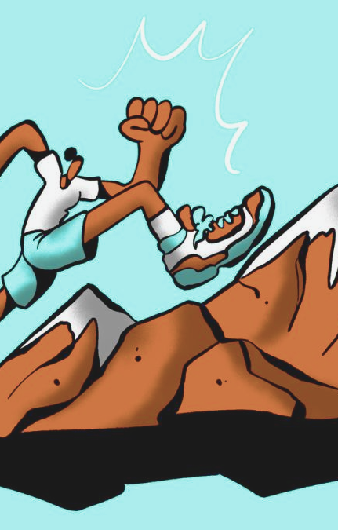
004
INTRODUCTION
Motivation
FIND ME | PARAGON INTERNATIONAL UNIVERSITY
Notes:
- To learn how search engine works under the hood
- To apply the knowledge been learned in Information Retrieval course
- To challenge ourselves with something we haven't done before

Slide 5

005
INTRODUCTION
Objectives
FIND ME | PARAGON INTERNATIONAL UNIVERSITY
Notes:
We want to build a search engine which user can search with keywords and compute the relevancy of the documents then return the documents back.
- Want to target only stackoverflow (hardware constraint). even that until now there are 99% of the stackoverflow's webpages that we haven't crawled.

Slide 6
MODELING
FIND ME | PARAGON INTERNATIONAL UNIVERSITY

Slide 7
007
TOOLS
1) Flask
2) Neo4J
3) Flutter
FIND ME | PARAGON INTERNATIONAL UNIVERSITY
For preprocessing and api
For datastore
For User Interface

Slide 8
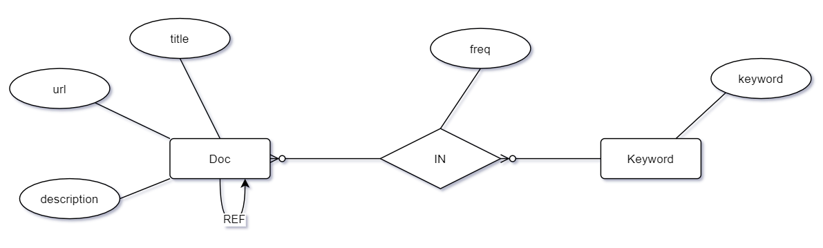
008
DIAGRAM
FIND ME | PARAGON INTERNATIONAL UNIVERSITY

Slide 9
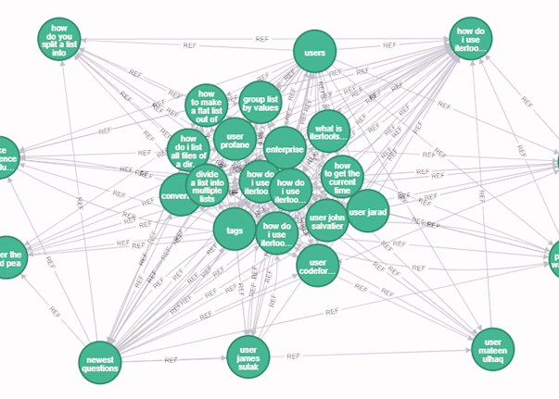
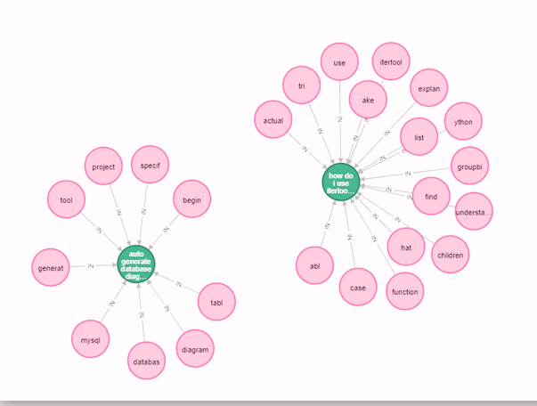
009
Graph representation of
the models
FIND ME | PARAGON INTERNATIONAL UNIVERSITY
Notes:
Let me show some visual examples of how our model looks like rather than just a diagram.

Slide 10
010
CRAWLING
Download Information from the webpage
COMPONENTS
INDEXING
Preprocessing to help ranking documents faster
RANKING
FIND ME | PARAGON INTERNATIONAL UNIVERSITY
Real time processing to score and rank document then return to the user

Slide 11
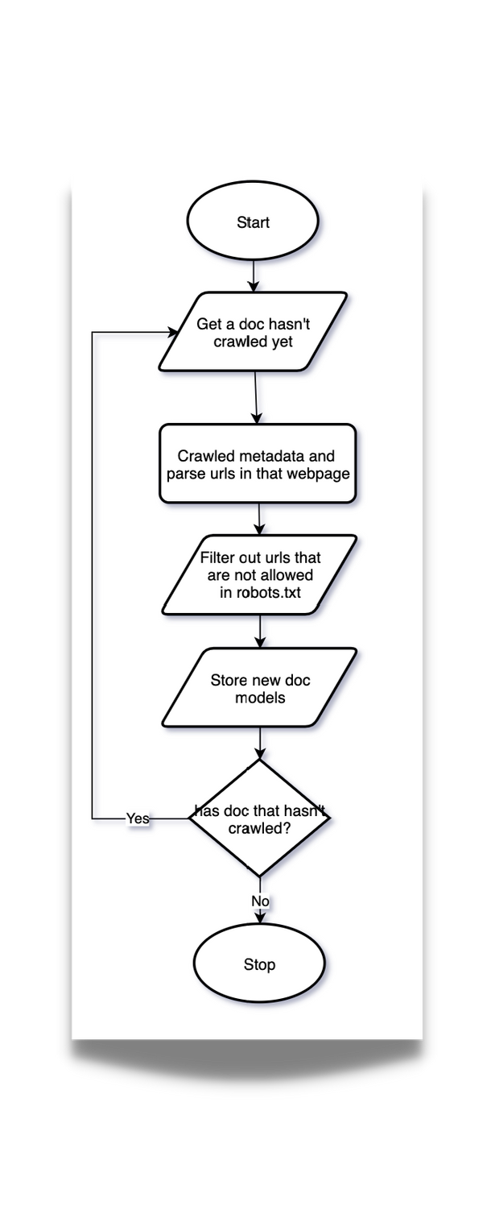
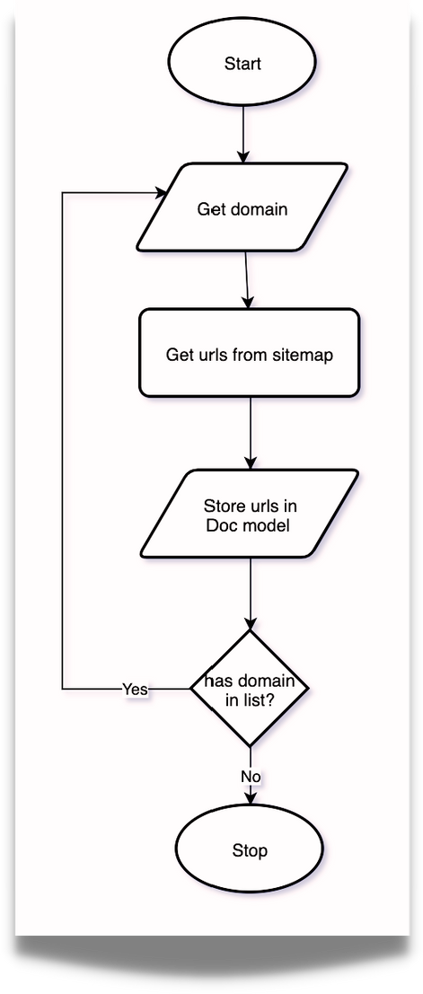
011
CRAWLING
FIND ME | PARAGON INTERNATIONAL UNIVERSITY

Slide 12
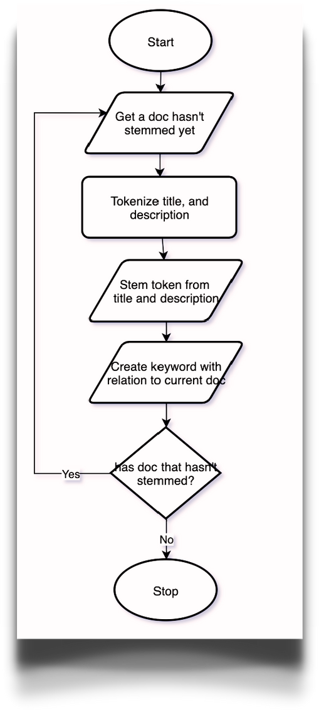
012
INDEXING
FIND ME | PARAGON INTERNATIONAL UNIVERSITY

Slide 13
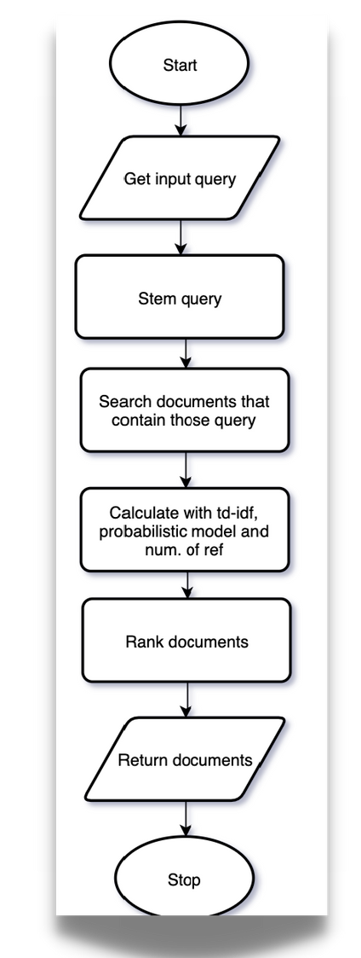
013
RANKING
FIND ME | PARAGON INTERNATIONAL UNIVERSITY
Notes:
- Cal with tf-idf, probab model and num. of ref. In this process, there are lots of things happen behind the scene.
- first we compute tf-idf then pipe it into sigmoid function.
For sigmoid fn is an activation fn which we plug the input and produce the output from 0-1. Doing this help us normalize the data and allow us to weight it with probab and num of ref scores.
- Next, we compute the probability of relevancy of the documents then pipe it into sigmoid function as well.
- Then, we count the num. of ref but this time instead of pipe it into the sigmoid fn we pipe it to minmax activation fn. becoz num. of ref can go really high which is not efficient to compute with sigmoid fn which uses exp fn. For minmax fn kinda do the same thing but with diff input and formula.
- Finally, we can combine it together weighted 0.5 for tf-idf score, and both 0.25 for probab score and num. of ref. The final score will be in range of 0-1.

Slide 14

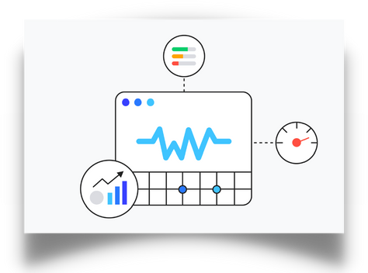
ELIF
CRAWLING & INDEXING
RANKING
FIND ME | PARAGON INTERNATIONAL UNIVERSITY
Fetch web pages
Parse title and description
Breaking into chunk of words (tokenization)
Reduce to base/root form (stemming)
Looking for more links
Tokenization and Stemming user query
Rank documents with bespoke algorithm.

Slide 15
DEMO
FIND ME | PARAGON INTERNATIONAL UNIVERSITY

Slide 16
5K+
7K+
016
Documents
in the datastore
Keywords
in the datastore
STATS
COMPARE TO STACKOVERFLOW
APPROX. 21M+ DOCUMENTS
0.025% completed
FIND ME | PARAGON INTERNATIONAL UNIVERSITY
COMPARE TO INTERNET
APPROX. 4.2B+ DOCUMENTS
0.0001% completed

Slide 17
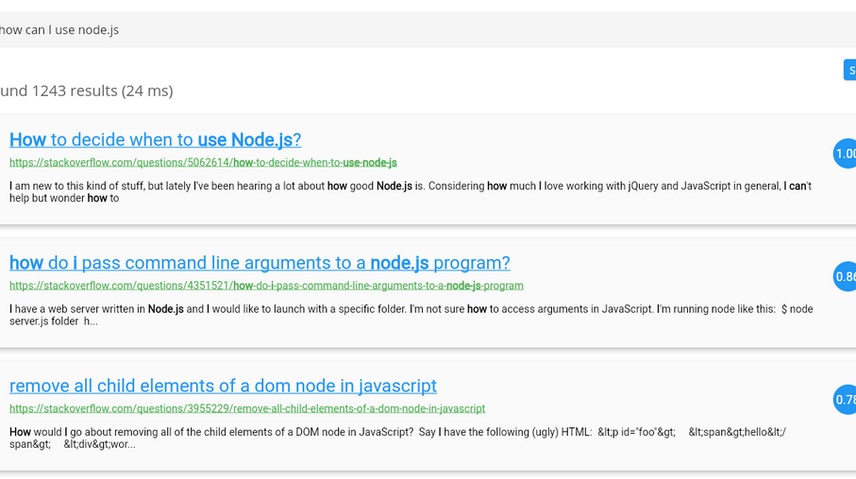
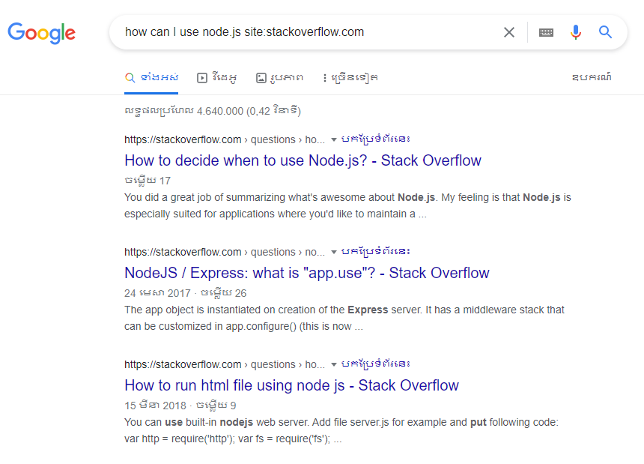
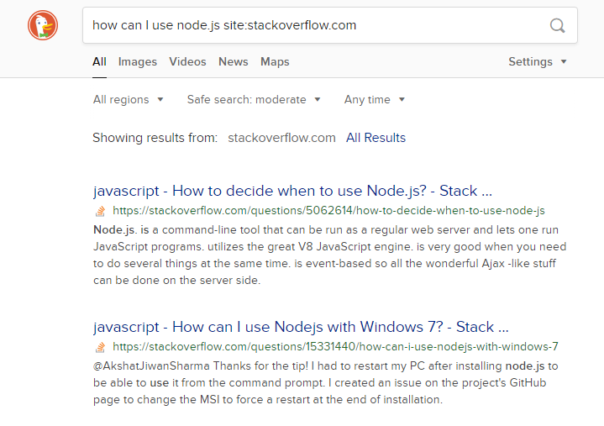
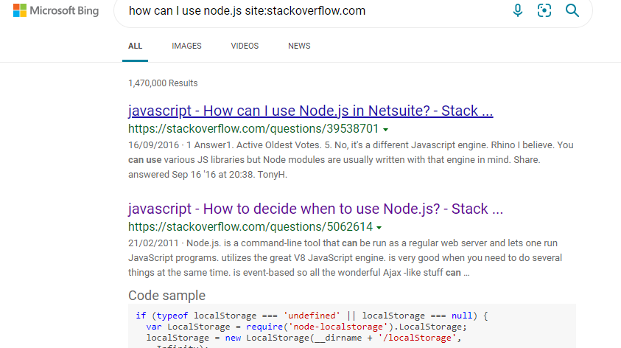
Notes:
This comparison does not mean to compete with other search engines but to test that if document is in our database, chances are we may be able to return the relevant docs to you. as of now becoz we cant not crawled the whole internet with our tiny machine.

Slide 18
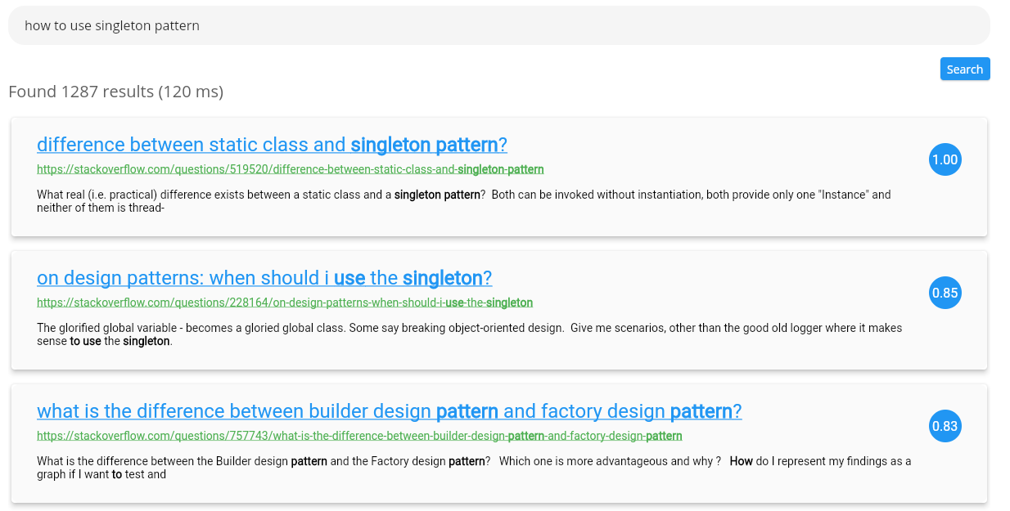

Slide 19
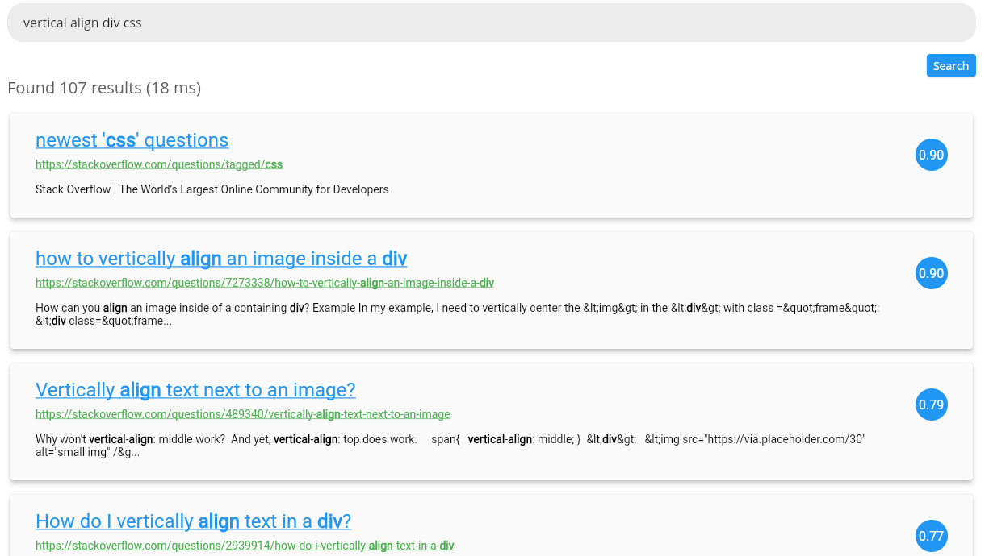
Notes:
Perform quite good compare to what we want to search for.

Slide 20
020
Most of the time, users are not reliable source of truth
To make a good search engine, time and resources are needed to produce a good algorithm with computational power to make querying consumes less time.
Search engine algorithms should change after a period of time
CONCLUSION
FIND ME | PARAGON INTERNATIONAL UNIVERSITY
Notes:
- dont know what to look for => probab model kicks in this situation
- mistake in grammar or parts of speech => stemming
3. If you can recall, we introduce ranking by num. of ref. This is easily be abused by the users.

Slide 21
021
THANK YOU FOR JOINING TODAY.
FIND ME | PARAGON INTERNATIONAL UNIVERSITY

